Slide 1
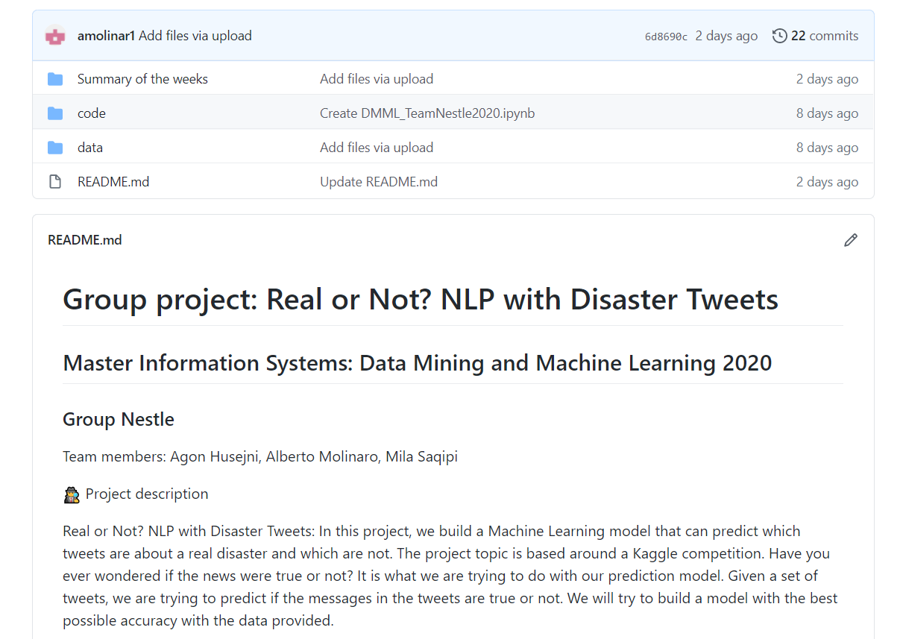
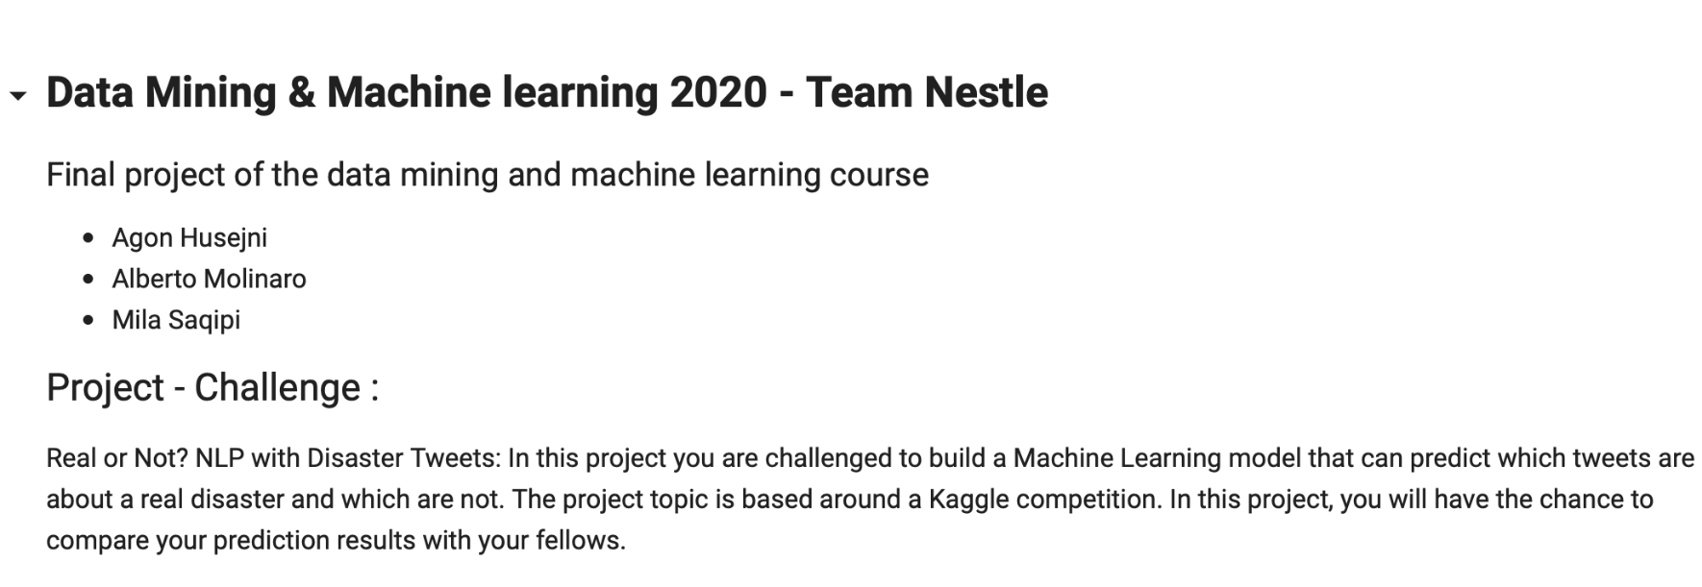

DATA MINING AND MACHINE LEARNING
SUMMARY OF THE WEEK 2
Final project
Task performed
GITHUB ADAPTATION
DATA CLEANING
SECOND SUBMISSION
TEAM NESTLE
Agon Husejni, Alberto Molinaro, Mila Saqipi

